Slide 1
Initiative 31: State of Work
Eclipse IDE Working Group On-Site
2025-02-12

Slide 2
Recap: Project Phases
Prototypes
Prototypes
Techn. 1
Ski(j)a + Custom Widgets
Techn. 2
Techn. 3
Mature, Maintained
SWT Implementations
Techn. 2
Mature, Maintained
SWT Implementations
Mature, Maintained
SWT Implementations
Mature, Maintained
SWT Implementations
MacOS
MacOS
MacOS
MacOS
Windows
Windows
Windows
Windows
Mature, Maintained
SWT Implementations
Linux
Linux
Linux
Linux
Techn. 2
Current
Prototype
Realization
Production
Replacement

Slide 3

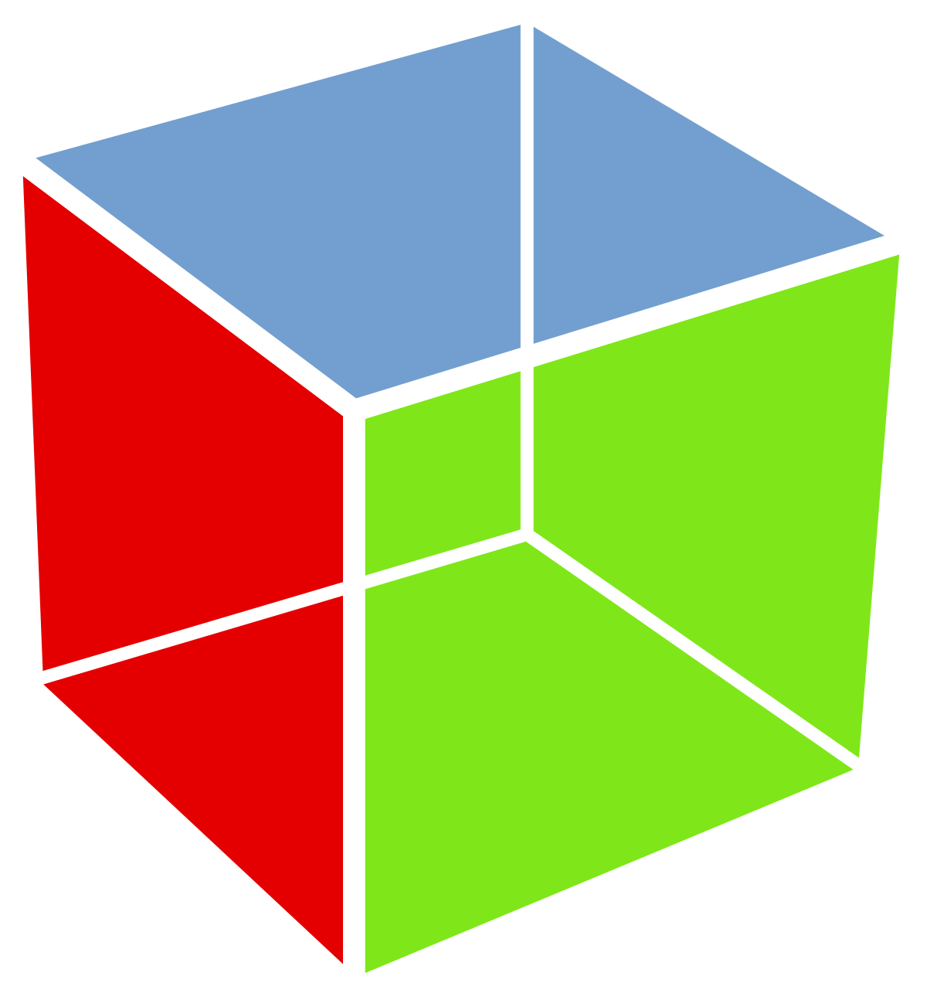

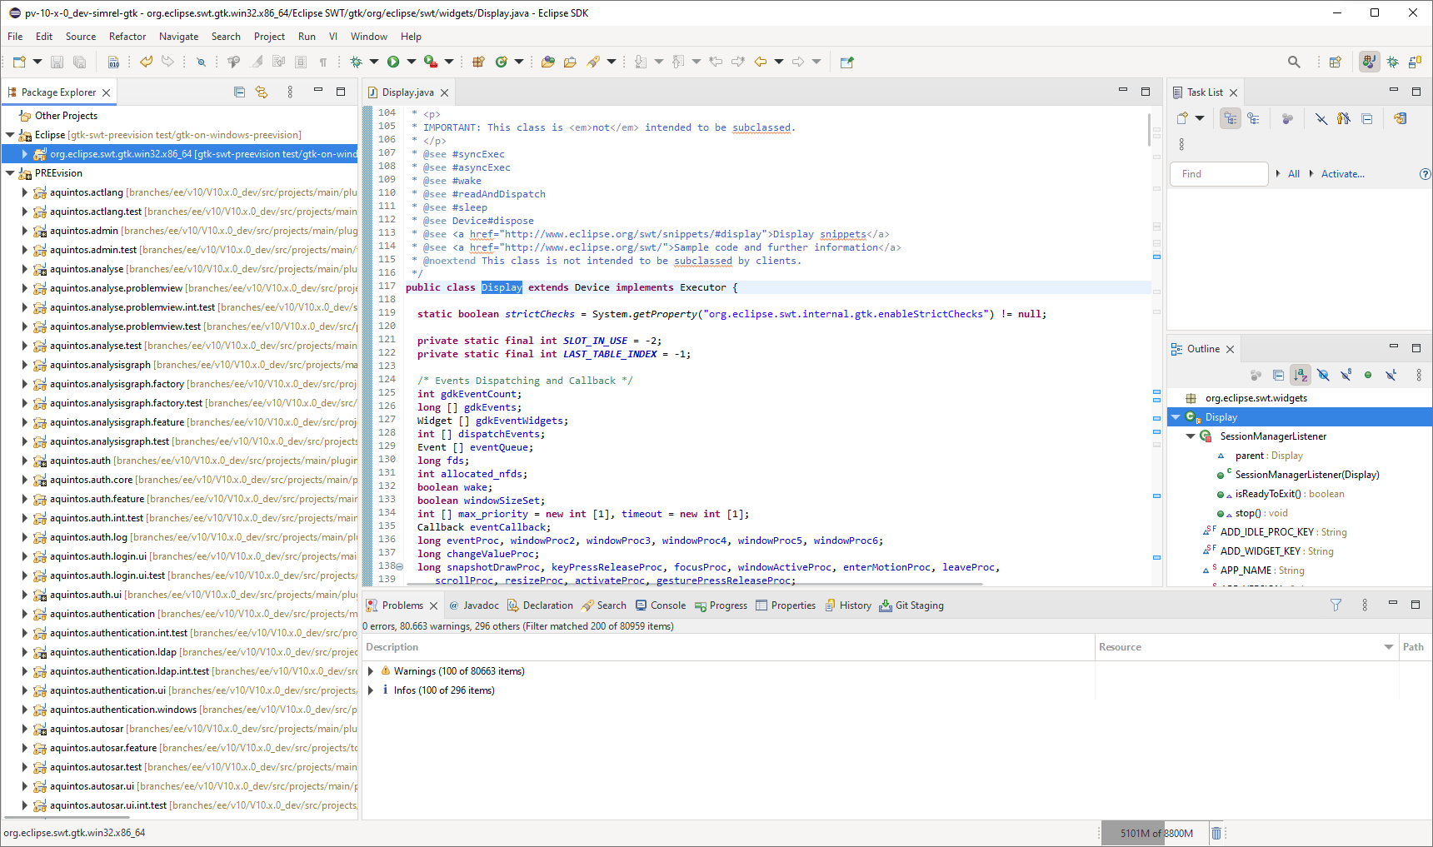
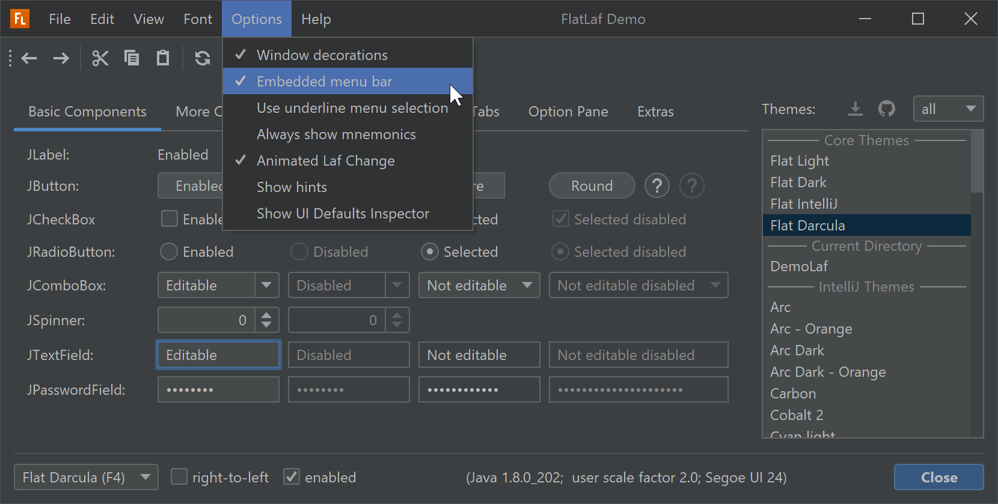
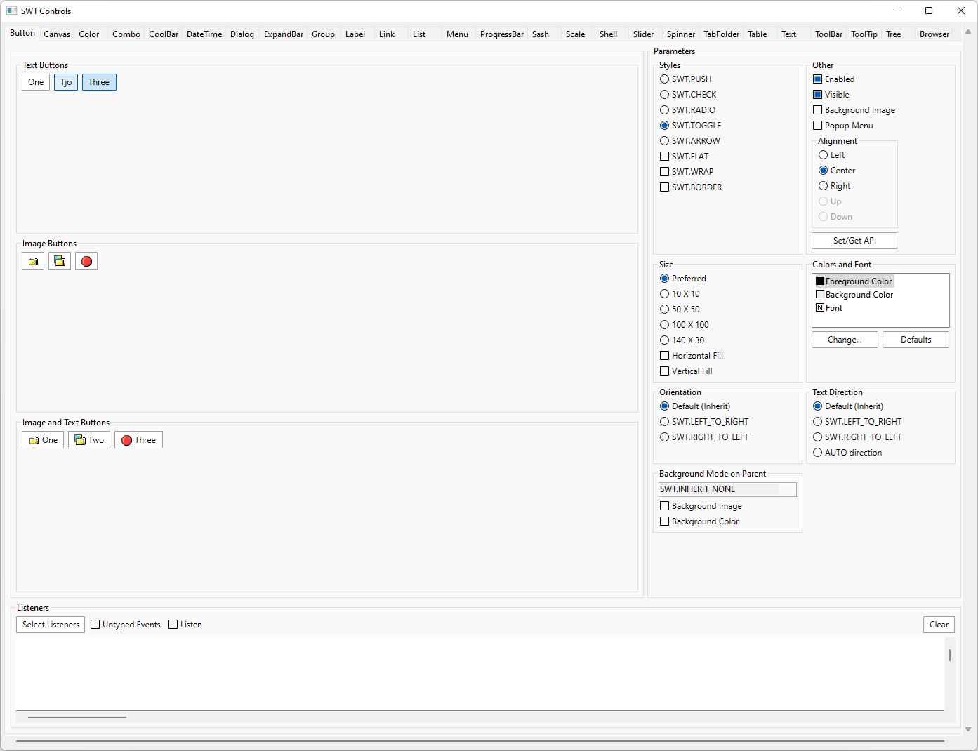
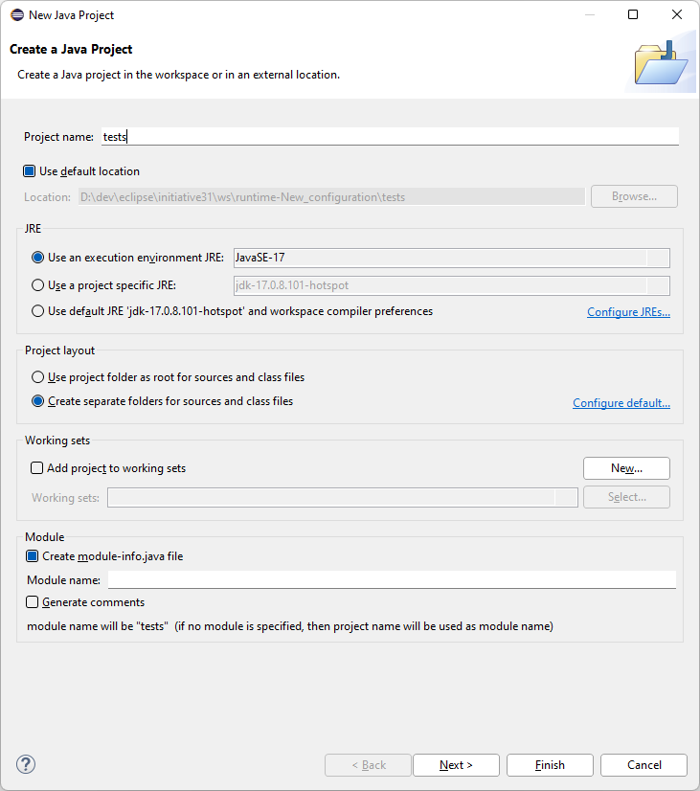
Current Technology Overview
GTK
with custom-drawn widgets
or LibreOffice/VCL widgets
No further investigation
No further investigation
  Implementation exists
  (for Linux)
  Windows/MacOS ports exist
  Native customizing via CSS
  GTK4 implementation required anyway
  Purely Java
  → skillset, deployment
  Platform independence
  (Java-supported ones)
  Partial implementation exists
  Theming, HiDPI, SVG support
  Modern, widely adopted rendering engine
  Platform independence
  (Skia-supported ones)
  Custom drawing:
    Purely Java → skillset
    Full control and flexibility

Slide 4
Achievements
Incremental Replacement: ControlExample / IDE still working
  Widgets: Button, Label, Scale, Text, List, StyledText (on Windows)
  Rendering possible with native GC and Skija GC
  Compatible with existing SWT HiDPI support
  Working on all three platforms
  CI: validation of compilation on all platforms
Experiments
  “One Canvas” solution (non-incremental)
  OpenGL (performance)

Slide 5
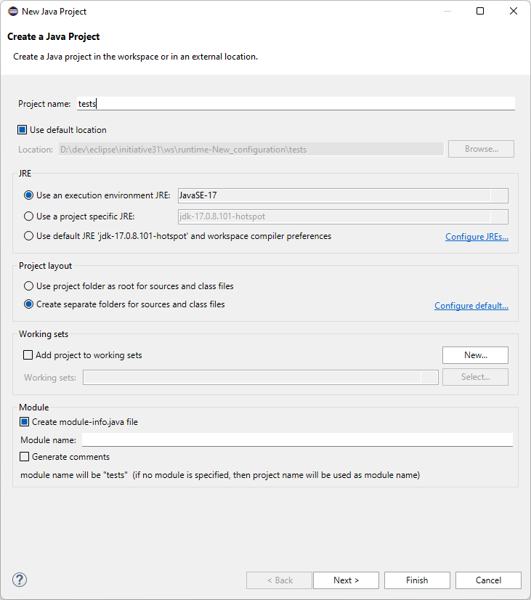
Custom-Drawn Widgets with Ski(j)a

Slide 6
Contributions
Most of them contributing part time
→ ~ 2-3 FTEs
Code Contributors
Denis Ungemach (SAP)
Dieter Mai (SYSGO)
Federico Jeanne (Vector)
Heiko Klare (Vector)
Latha Patil (ETAS)
Praveen S K (SAP)
Thomas Singer (Syntevo)
New: Raghundana M (Advantest)
Discussion Contributors
Alex Kurtakov (Red Hat)
Dominic Scharfe (COSEDA)
Harald Mackamul (Bosch)
Theo Dann-Muirhead (Renesas)
William Riley (Renesas)

Slide 7
Opportunities for Incremental Process
Integrate ability to exchange renderer for pure rendering tasks
  Ski(j)a rendering could be used instead of native rendering
  For performance-critical, custom-drawn contents (e.g., GEF diagrams)
Incremental replacement of native with custom-drawn widgets
  Might reduce performance with native custom rendering (GC)
  Lock-in approach (or difficult to preserve native widgets next to their custom-drawn replacements)
  Messy integration of custom-drawn widgets with other native widgets

Slide 8
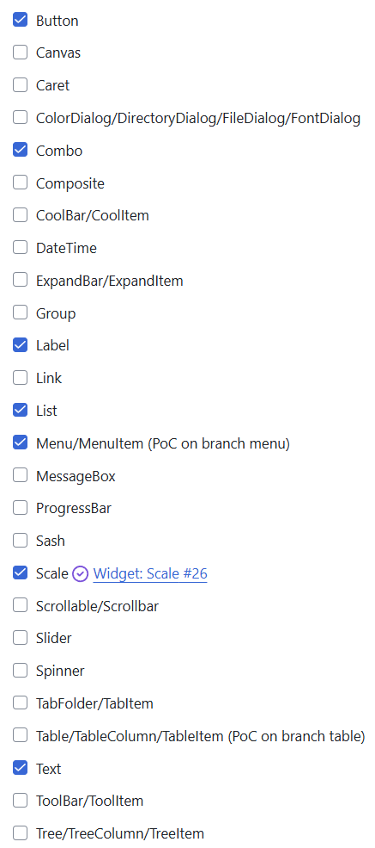
State Summary
7/26 widget groups
(of different complexity)
Cross-cutting topics
(currently only prototyped)
Custom event handling
Efficiency of Skija rendering
Hardware acceleration
…
How long will it take?
Too long with the current number of contributors
How many contributors do we need?
Significantly more (>> 5 FTEs)

Slide 9
Thank you for the work done so far!

